Slide 1
Developing customizations and extensions for Dynamics 365 for Finance and Operations using Git for source control and continuous integration

Slide 2
Just use Git. TFVC Sucks. We can say that now.

Slide 3

The Good Place Rules of Communication

Slide 4
Nathan Clouse Technical Architect enVista LLC Microsoft Business Applications MVP nclouse@envistacorp.com www.atomicax.com www.dynamics.fo @NathanClouseAX

Slide 5
Introduction to Git
Branching and Merging
Yes, we have to talk about TFVC
Definition and importance of continuous integration (CI)
Deployment options
YAML
Shifting to using Git and CI
Versioning customizations and extensions

Slide 6
What is Git and How Does it Work?
Git is a DevOps tool used for source code management.
It is a free and open-source version control system used to handle small to very large projects efficiently.
Git is used to track changes in the source code, enabling multiple developers to work together on non-linear development.

Slide 7
Mandatory TFVC Slide
TFVC has Official* MSFT Support
Git does not*
If you like TFVC and it’s given you no problems, great!
If that’s not you, we have other options
Focus on Git for Azure DevOps

Slide 8
Git has some Official* Docs now!
https://playbook.microsoft.com/code-with-fusionops/FusionOps-for-Dynamics-365-Finance/Guides/GIT_walk_through/

Slide 9
Why Use Git?
Modern, not monolithic
Branches are short lived, few conflicts, less maintenance
Pull Based rather than push based
If you’re used to TFVC, requires a change in thinking
Continuous integration
Continuous delivery

Slide 10
Version Control isn’t Hard
Git
Subversion (SVN)
Mercurial
Perforce (Helix Core)
Concurrent Versions System (CVS)
Bazaar
Monotone
Fossil
ClearCase
Visual SourceSafe (VSS)
Team Foundation Version Control (TFVC)
BitKeeper
Darcs
Plastic SCM
Regice
Code Co-op
Aegis
RCS (Revision Control System)
SCCS (Source Code Control System)
CA Harvest Software Change Manager
Notes:
One of these is a pokemon

Slide 11
Basic Git Workflow for Developer
VS 2017 / 2019 / 2022*
Get work
Get Branch
Do work
Test work
Commit Work (at any time)
Get continuous integration feedback
(re-test work)
(re-do work)
Create Pull Request (PR) (that will delete the branch)

Slide 12
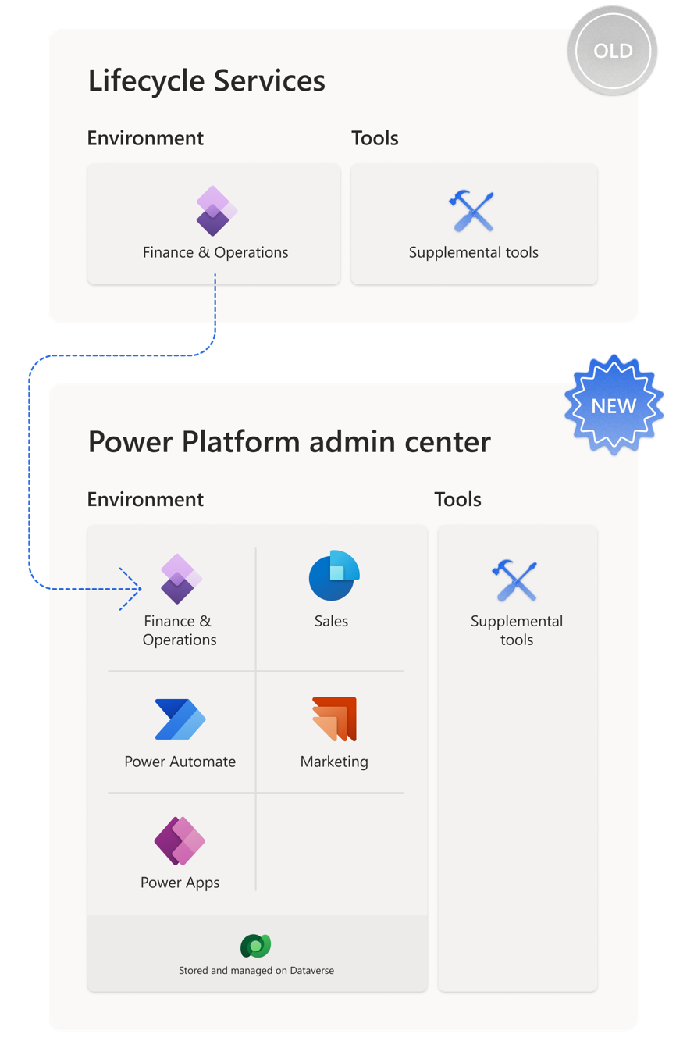
Unified Platform
https://www.powerazure365.com/blog-1/dynamics-365-finops-unified-developer-experience

Slide 13
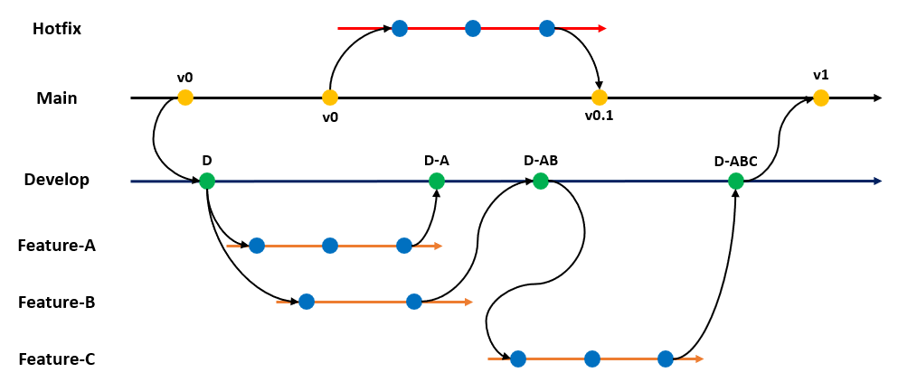
Git Branching
Time

Slide 14
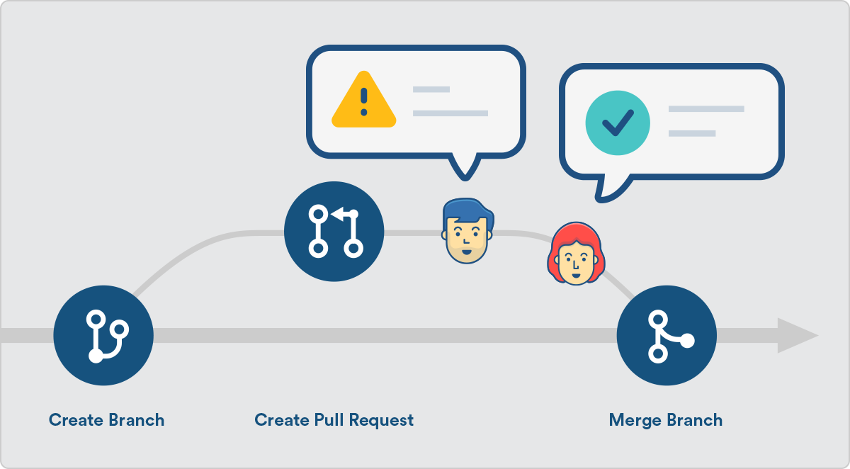
Pull Request (PR)
What is a PR?
Who creates them?
Who reviews them?
What verifies them?
What merges them?
Who approves them?

Slide 15
Pull Request (PR)
Review
Approve

Slide 16
Pull Request (PR)
What is a PR?
Who creates them?
Who reviews them?
What verifies them?
What merges them?
Who approves them?

Slide 17

Code Reviews

Slide 18
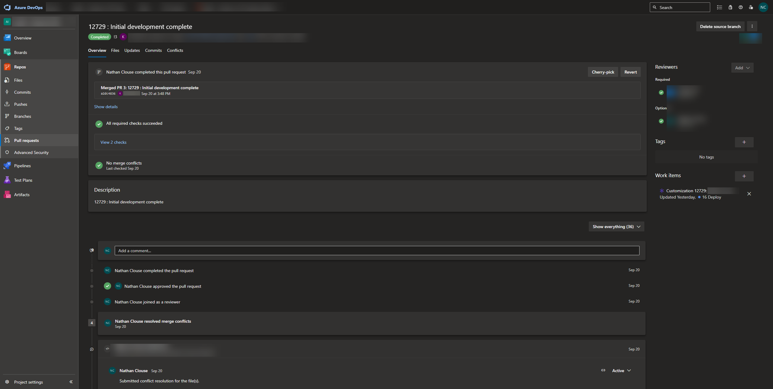
Resolving Conflicts

Slide 19
Notes:
Overview – all activity
Files – all files in the PR
Updates – activity for this PR
Conflicts
Commits – all commits included in this PR ( all commits for the branch )

Slide 20
Resolving Conflicts

Slide 21
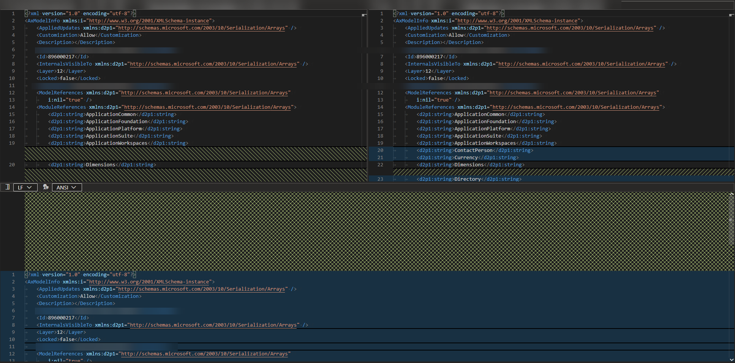
Mering Conflicts
Notes:
Can use web, can use outside tools, paste result in the bottom pane

Slide 22
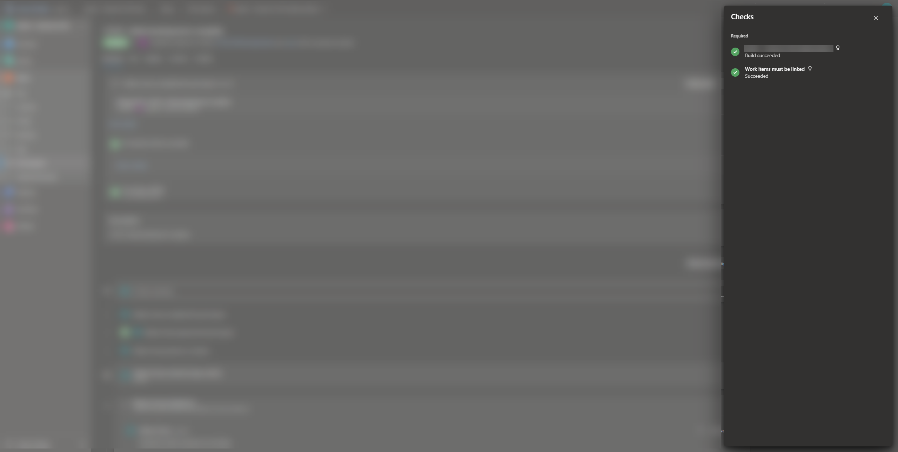
Continuous Integration

Slide 24
Continuous Integration

Slide 25
But what is Continuous Integration (CI)?
Automated process of integrating code changes into a shared repository multiple times a day/hour/minute. 1800 build minutes per month free.
Automated Builds: Validates code changes don't introduce build errors.
Automated Testing: Ensures no regressions or new bugs.
Immediate Feedback: Developers notified instantly if issues arise.
Notes:
1800 / 20 = 90 free builds per month

Slide 26
But what is Continuous Integration (CI)?
Frequent Commits: Encourages smaller, manageable changes.
Shared Repository: Everyone works on the latest code version or nearly the latest. Talk more on this in a bit.
Consistency: Maintains a consistent quality level.
Collaboration: Promotes teamwork among developers, testers, and operations.

Slide 27
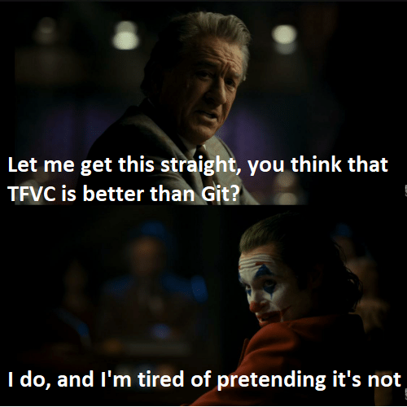
Absolute Madness

Slide 28
YAML
What is YAML?
What can it do?
Examples
Build on commit
Build on PR (pre-merge and build)
Test on PR
Schedule

Slide 29
Continuous Integration

Slide 31
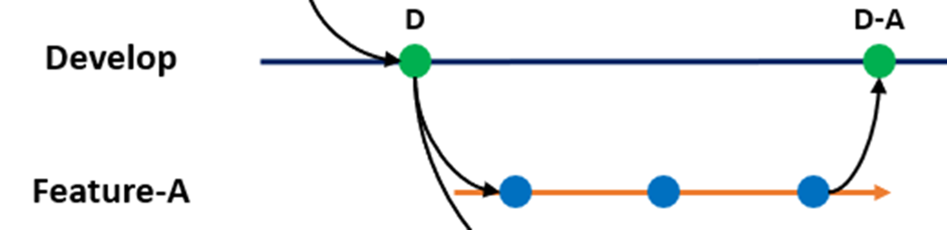

Slide 32
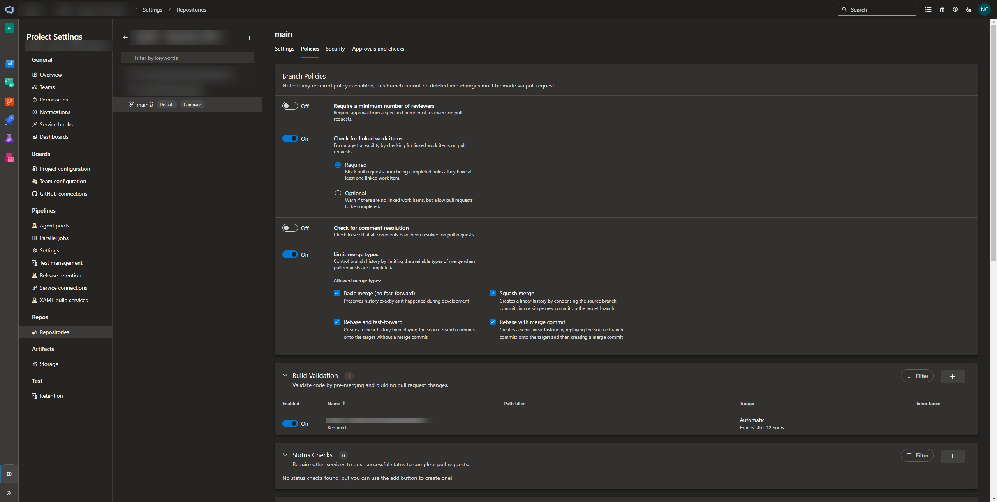

Slide 36
Alternatives for Git Hosting
GitHub?
GitLab?
Bitbucket?
Sure. Still need Azure DevOps for 1 thing*…

Slide 37
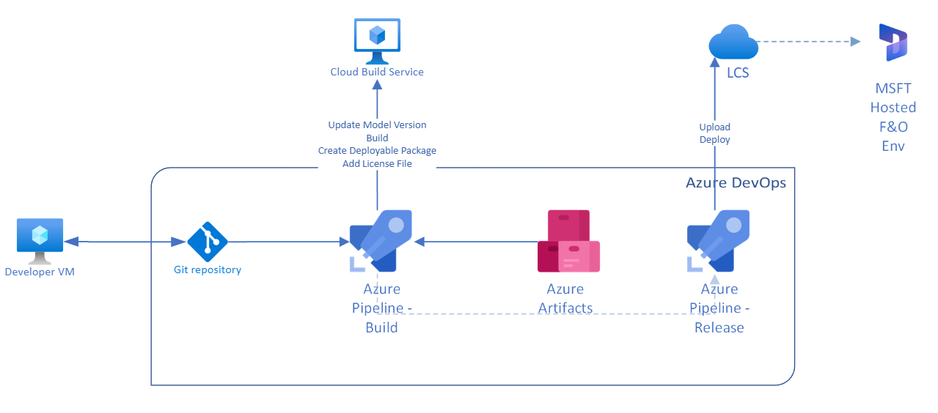
Continuous Delivery (CD)

Slide 38
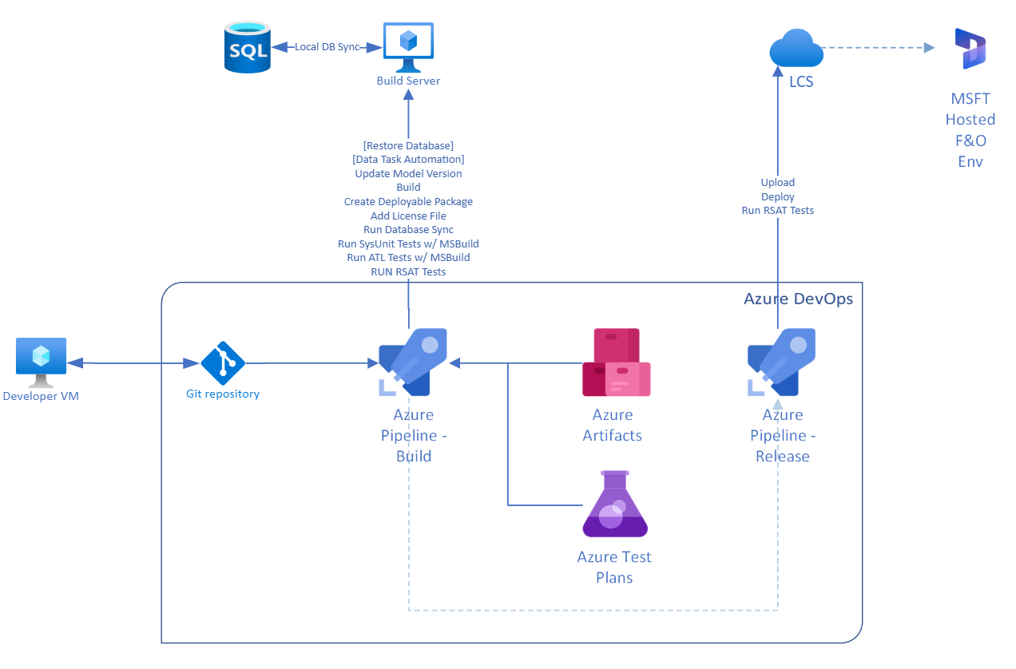
Continuous Delivery (CD)

Slide 39
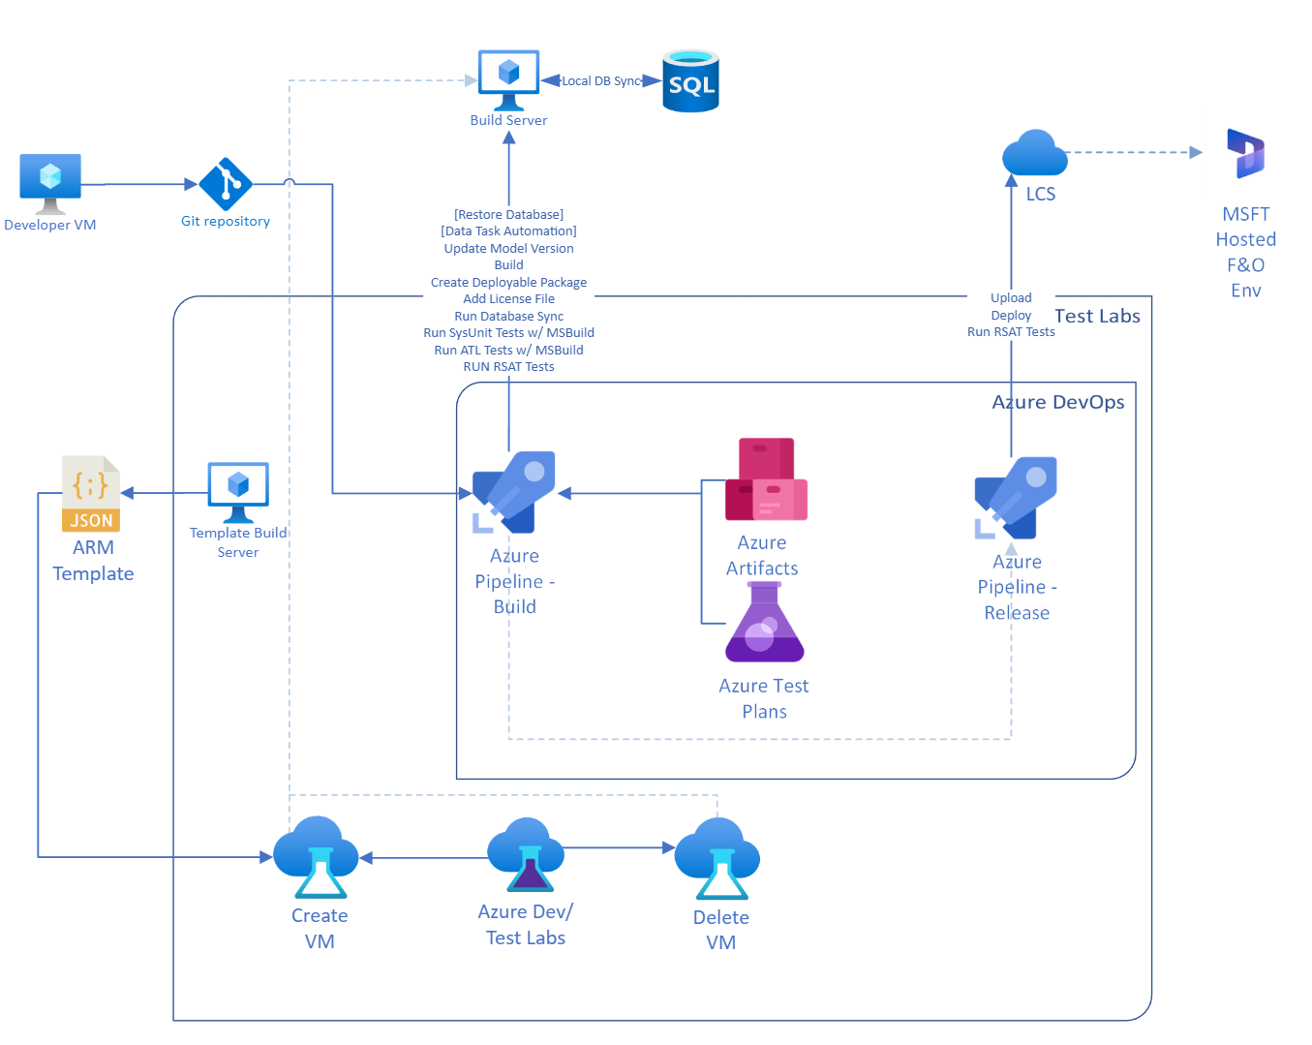
Continuous Delivery (CD)

Slide 40
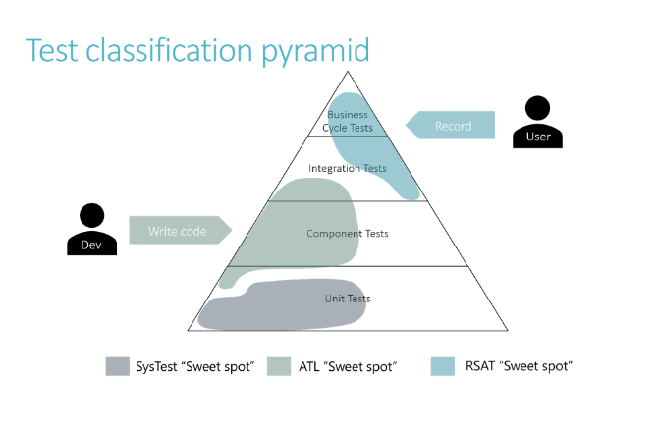
Testing

Slide 41
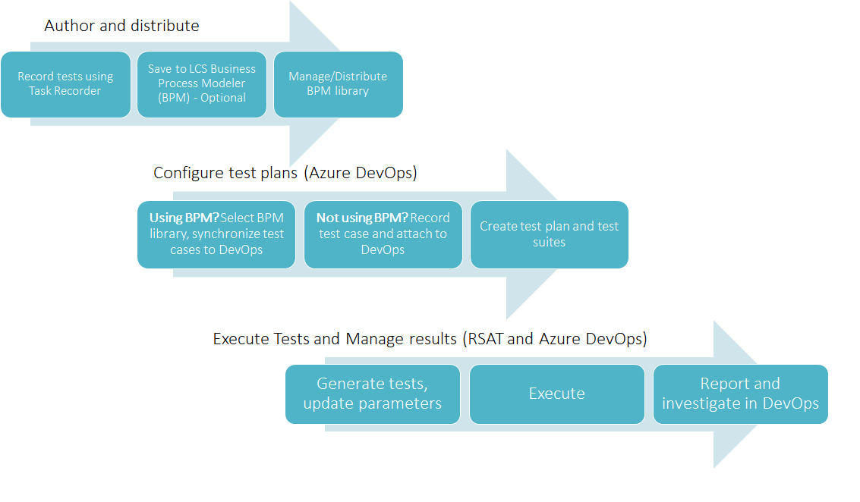
Testing

Slide 42
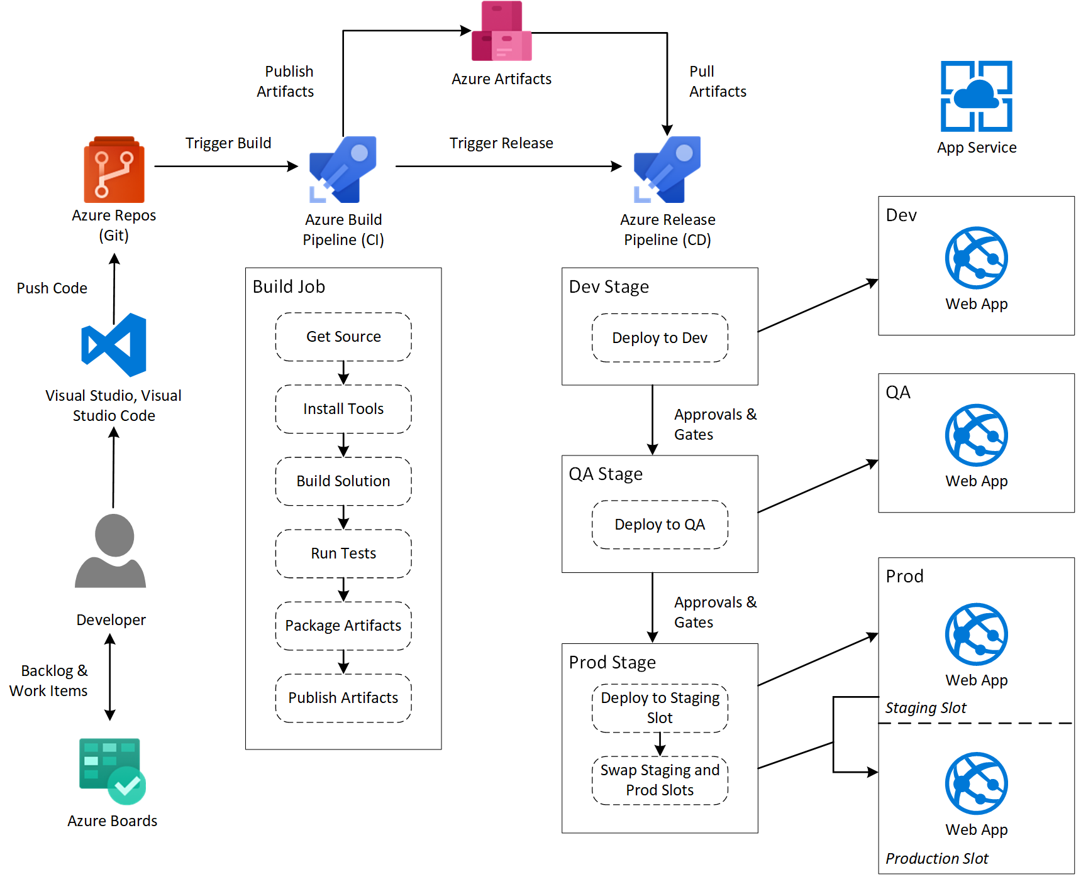
New Feedback Loop

Slide 43
Recap
Use Git
Branch
Develop
PR
Build
Test
Deploy

Slide 44
Sources
http://www.atomicax.com/article/giting-started-git-d365fo-and-other-puns
http://www.atomicax.com/article/getting-started-gated-checkins
http://www.atomicax.com/article/moving-tfvc-git-azdo
http://www.atomicax.com/article/staging-and-git
http://www.atomicax.com/content/git-alm-field-guide
https://ariste.info/en/dynamics365almguide/welcome/
https://github.com/microsoft/Dynamics365-Xpp-Samples-Tools/tree/master/CI-CD/Pipeline-Samples
https://playbook.microsoft.com/code-with-fusionops/FusionOps-for-Dynamics-365-Finance/Guides/GIT_walk_through/

